Slide 1


A Fully Differentiable Pipeline for the Optimization of TAMBO
Zlatan Dimitrov, Hamza Hanif, Jay Agarwal, Izan Flórez García, Jeffrey Lazar, Pietro Vischia, Tommaso Dorigo
z.dimitrov308@proton.me

Slide 2
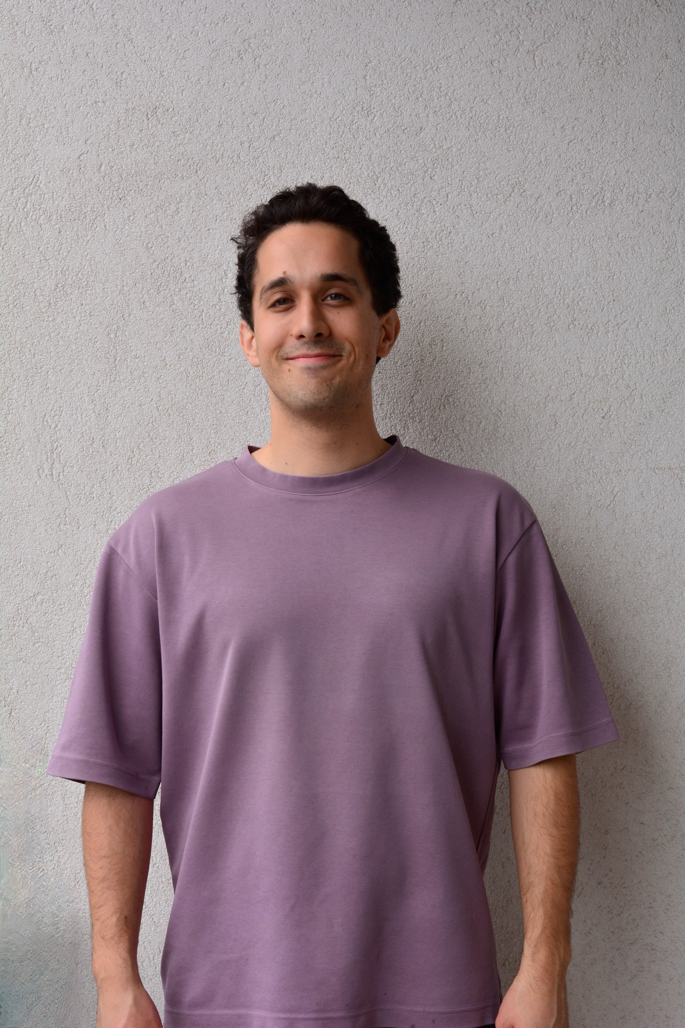
About me: Zlatan Dimitrov
Sep 2025 –
PhD Student, GATE Institute | MODE
Uncertainty quantification, surrogate models, differentiable programming
Sep 2024 – Sep 2025
Researcher, Sofia University St. Kliment Ohridski
Machine learning applications in electromagnetic simulations
2022 – 2024
MSc, Electromagnetics, Fusion and Space Engineering, KTH Royal Institute of Technology
Electromagnetics and Machine learning (Ericsson AB/KTH)
2018 – 2022
BSc, Information Technology / Electrical Engineering, TU Vienna / Aalto University

Slide 3
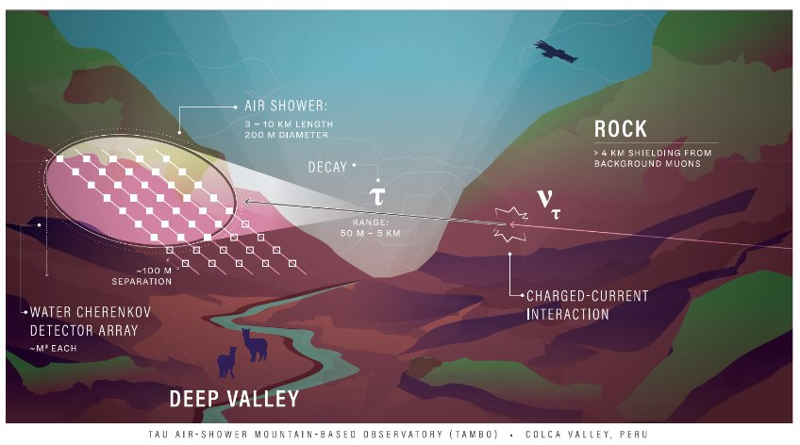
The TAMBO experiment
TAMBO (Tau Air Shower Mountain-Based Observatory)
Earth-skimming tau neutrinos
Detection of particle showers resulting from tau leptons interactions with the dense rock in the valley
100 detection units, which need to be positioned efficiently on the walls of the Colca Valley in the Peruvian Andes.
This presentation focuses on the use of surrogate models and differentiable programming in the optimization of the detector array.
[1] Pavel Zhelnin, Ibrahim Safa, Andres Romero-Wolf, and Carlos A. Argüelles. TAMBO: Searching for Astrophysical Tau Neutrinos in the Andes . PoS ICHEP2022 566.
[2] “IceCube Neutrino Observatory Home,” IceCube, Dec. 08, 2025. https://icecube.wisc.edu/

Slide 4
FM Model
(tau -> shower)
Random tau
parameters
x, y locations (trainable)

Slide 5
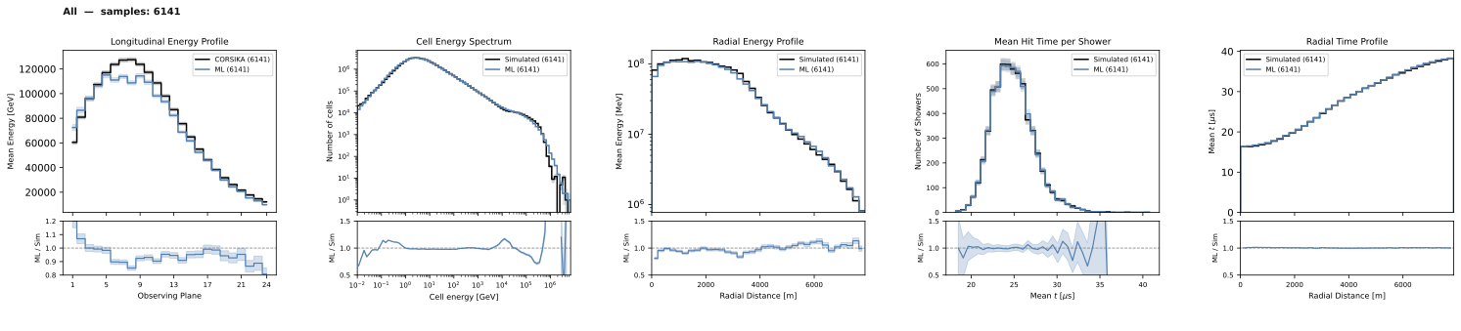
Flow-matching based surrogate model
Architecture
Parallel models for secondary species: proton, muon, electron
Based on the AllShowers architecture [1]
  transformer-based with block masks for custom attention window sizes,
  generative architecture is based on flow matching
Trained on 50k electromagnetic and 50k hadronic CORSIKA simulations
Output
Particle cloud representing the shower’s secondary particles
  x, y, z coordinates; Energy and time
shower (flow matching)
final shower
[1] T. Buss, H. Day-Hall, F. Gaede, G. Kasieczka, and K. Krüger, “AllShowers: One model for all calorimeter showers,” arXiv.org, Jan. 16, 2026. https://arxiv.org/abs/2601.11716

Slide 6
FM Model
(tau -> shower)
Reconstruction NN
(detected shower -> tau)
Random tau
parameters
Utility (reconstructed tau)
.backward()
x, y locations (trainable)

Slide 7
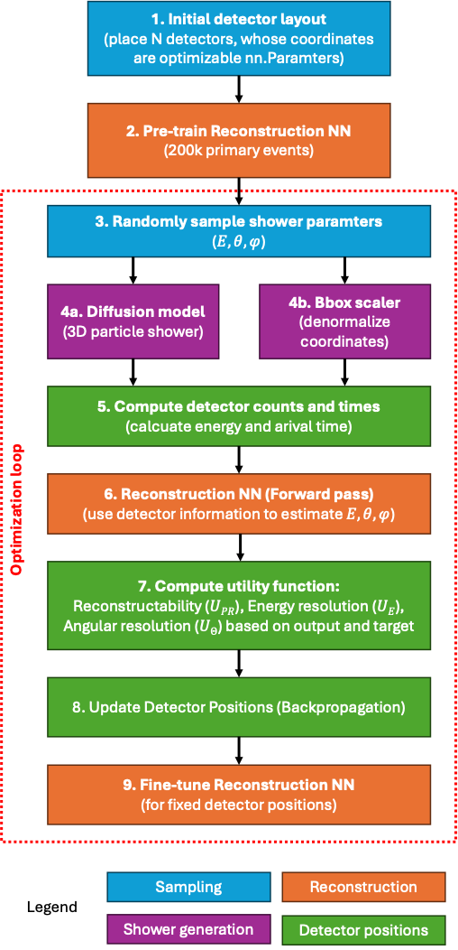
Detector location optimization (SWGOLO)
Pre-train Reconstruction NN on 200k primary events
Loop:
Use NN to reconstruct primary features from secondary events
Calculate utility (U) for 500 events
Update detector positions vie backpropagation
Every 5 epochs:
  fine-tune the Reconstruction NN on 5k samples
primary
shower (FM)
detector positions
Reconstruction NN
[1] Noyan, U. , “Optimization of the SWGO array with gradient descent algorithms,” GitHub. https://github.com/tdorigo/SWGOLO/tree/main

Slide 8
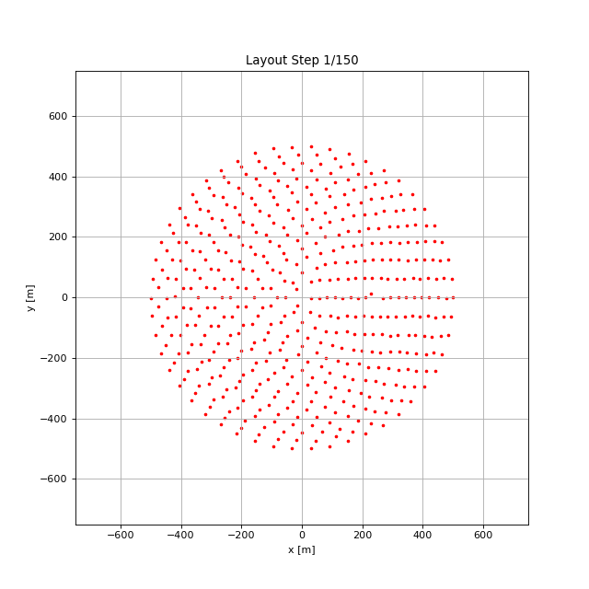
Stuck gradients problem
Currently the locations update
However, those updates are not well directed and the overall utility stays low
primary
shower (FM)
detector positions
Reconstruction NN

Slide 9
Detector response model
Reconstruction model
FM Model
(tau -> shower)
Reconstruction NN
(detected shower -> tau)
Tau decay
parameters
Utility (reconstructed tau)
.backward()
x, y locations (trainable)
x, y locations (trainable)
[1] X. T. Nguyen et al., “Differentiable Surrogate for Detector Simulation and Design with Diffusion Models,” arXiv.org, Jan. 09, 2026. https://arxiv.org/abs/2601.07859v1

Slide 10
Stage 1: Data preparation
Prepare 750k tau decay locations + energies
Trigger surrogate model to generate a space shower, based on the
  Direction of the primary particle (nx, ny, nz)
  Energy of primary particle
This shower is then shifted to the primary decay location
Match each shower with 5 detector layouts sampled randomly using Gaussian, uniform, lattice hypercube sampling
FM Model
(tau -> shower)
Tau decay
parameters
E, T at detectors

Slide 11
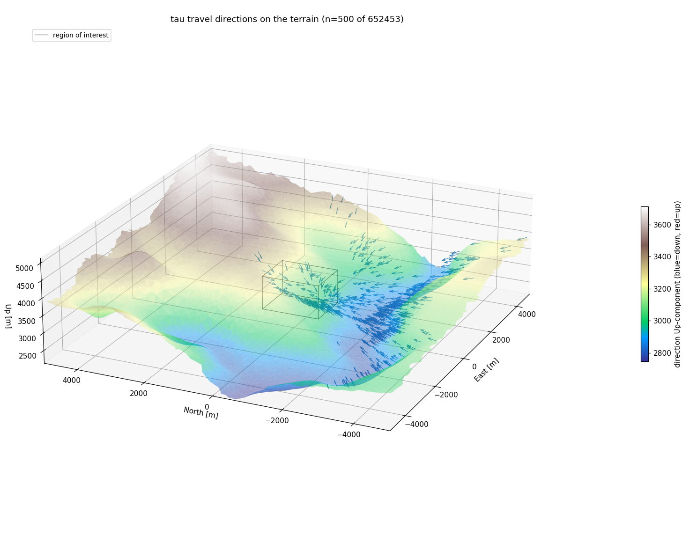
Stage 1: Data preparation – tau directions

Slide 12
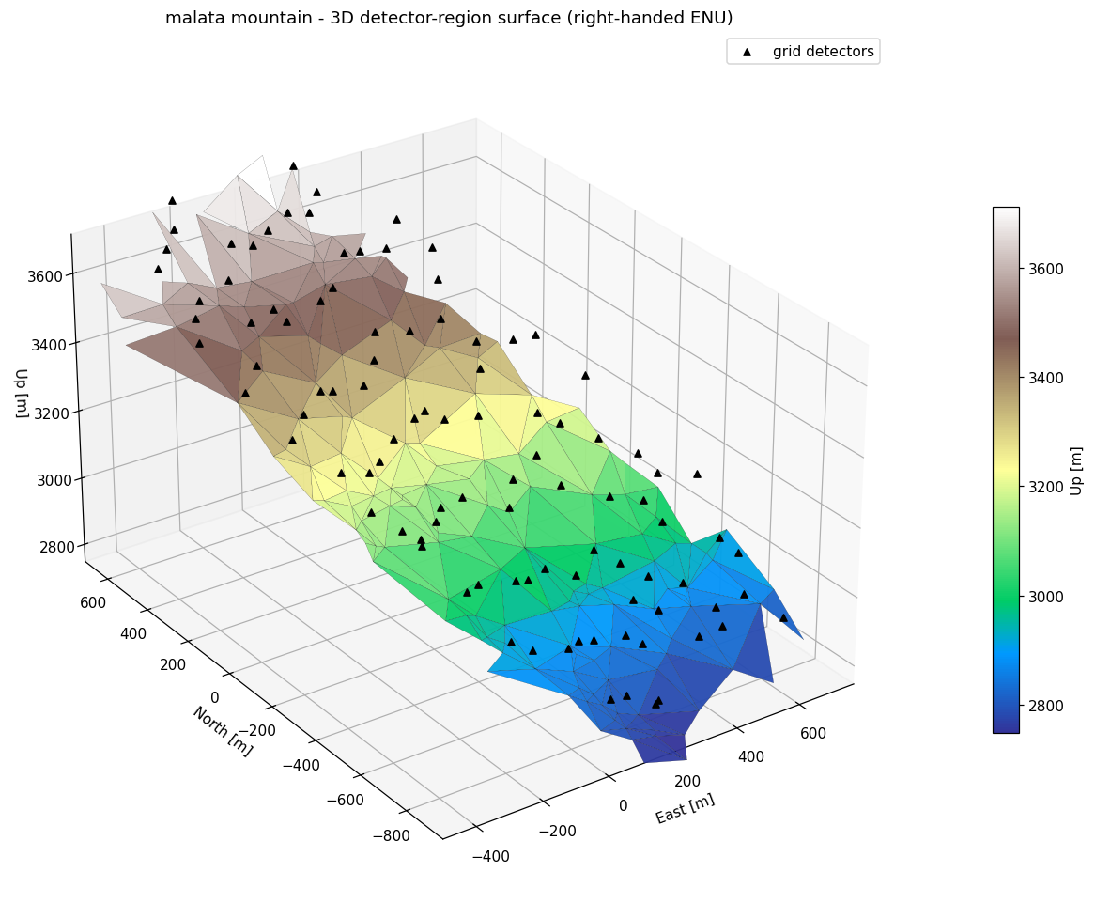
Stage 1: Data preparation – detector locations

Slide 13
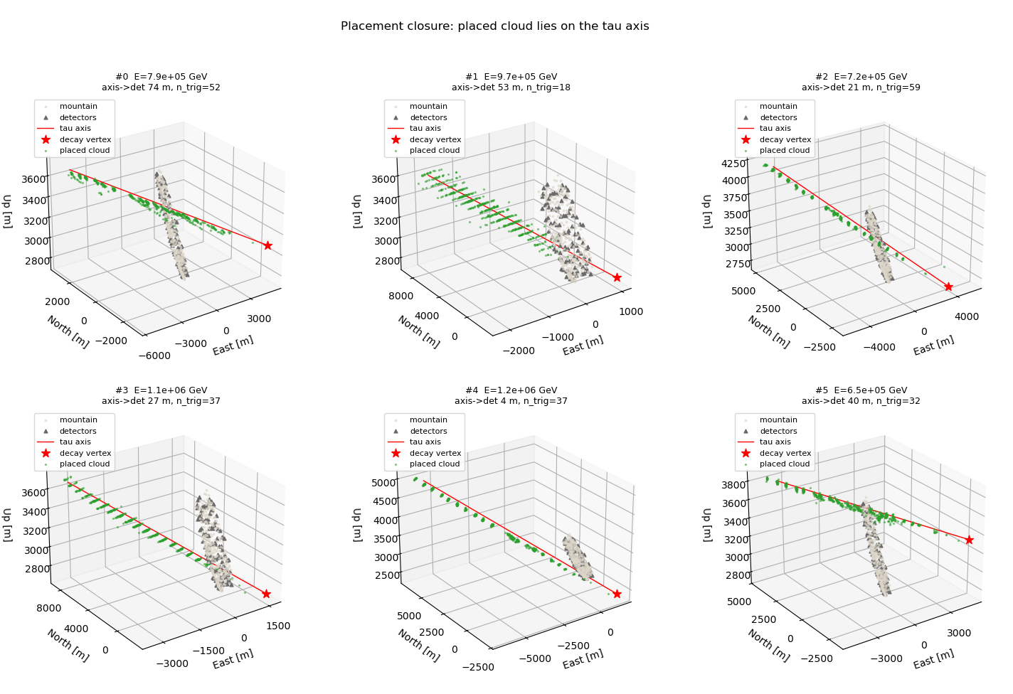
Stage 1: Data preparation – shower placement

Slide 14
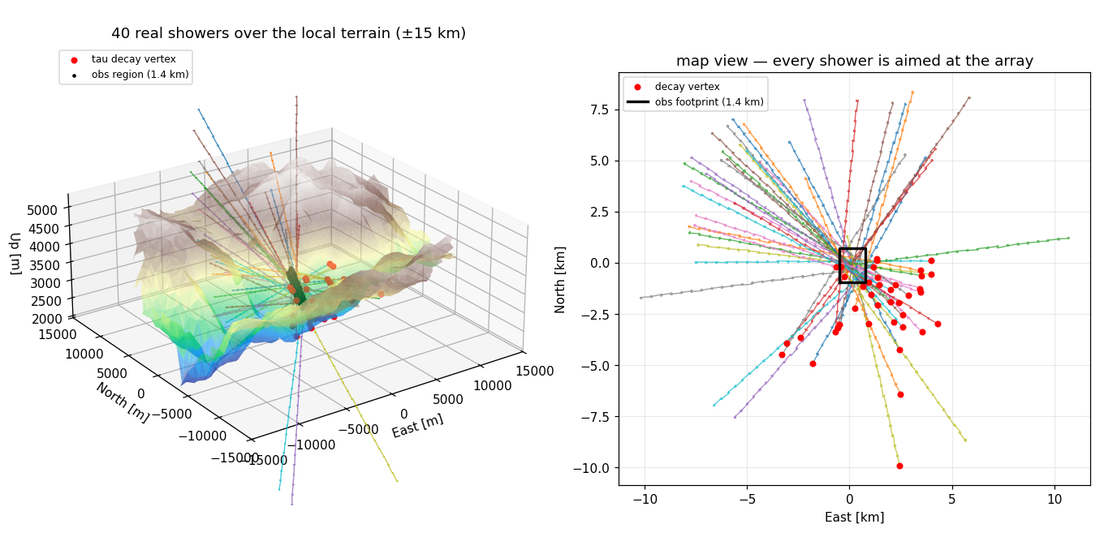
Stage 1: Data preparation – shower placement (2)

Slide 15
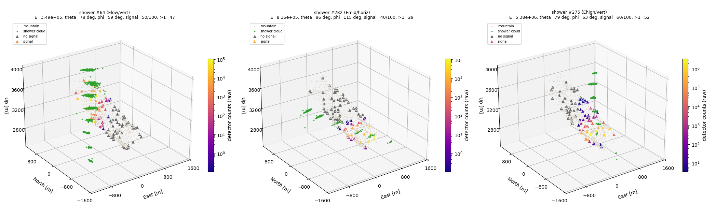
Stage 1: Data preparation – detector activation

Slide 16
Stage 2: Detector response
Detector response model
FM Model
(tau -> shower)
Deepsets NN to get detector response
Inputs:
  x, y coordinates of detectors,
  primary particle characteristics
Output
  E and T at each detector
Detector locations permuted during training
Parallel NNs for each particle type:
  Outputs for each detector:
  sum of energies
  count weighted mean of arrival times
Tau decay
parameters
x, y detectors
E, T at detectors
Tau primary (q)
100x
per-detector tokens
[primary, x, y]
encoder
mean context layer
(invariance)
decoder
E, T (mean + variance)
at each detector
100 x, y locations

Slide 17
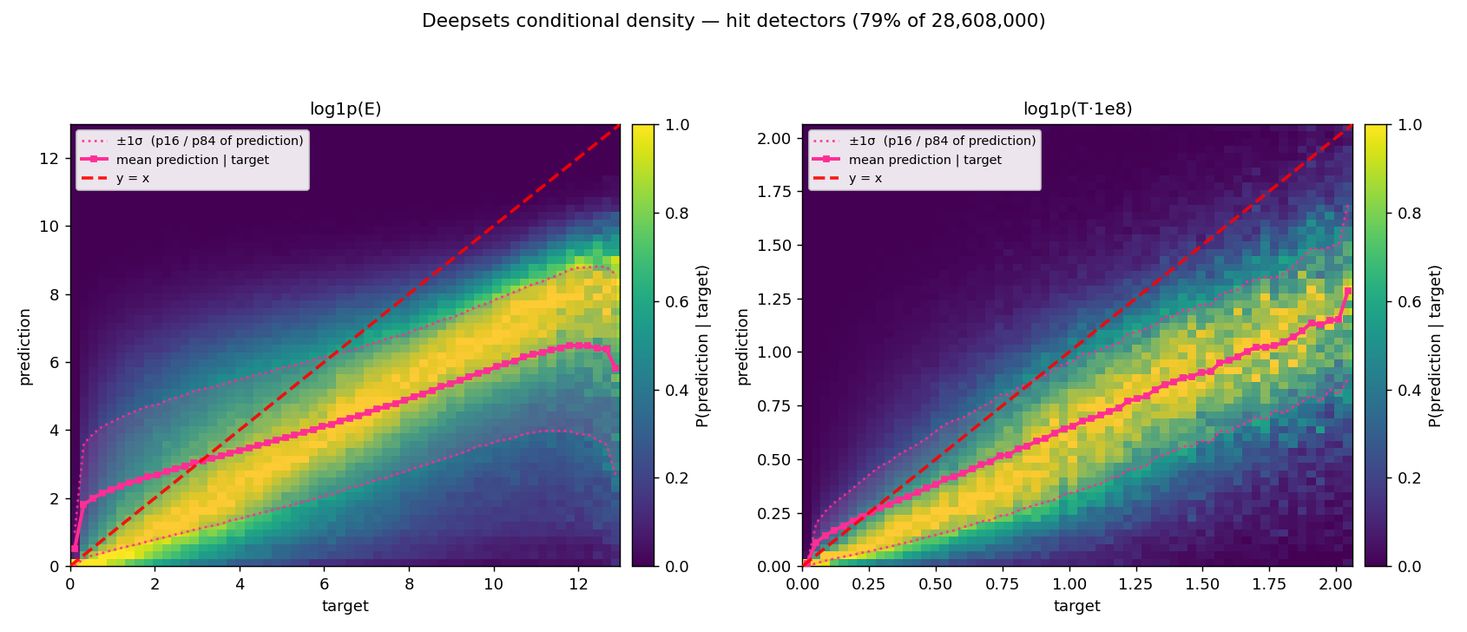
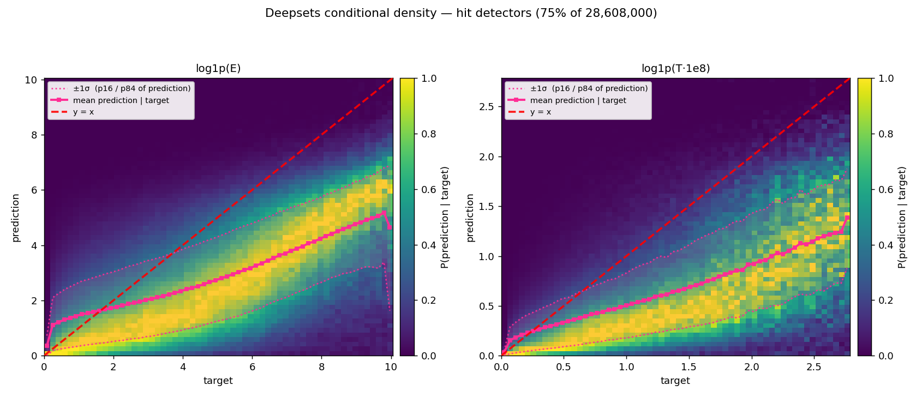
Stage 2: Detector response
Detector response model
FM Model
(tau -> shower)
Training error converges to the stochiasticity level in each shower
Experiemnts are run with a mean + variance NN to achieve sochiastic behavior of the surrogate
This approach would enable the further stages to be trained more robustly
Tau decay
parameters
x, y detectors
E, T at detectors

Slide 18
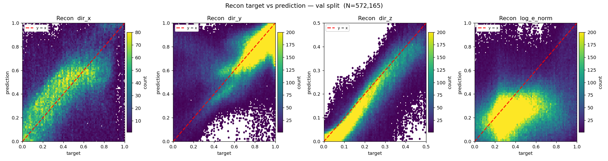
Stage 3: Reconstruction
Reconstruction model
Input
  Location, energy, time of arrival at each detector
Output
  Regenerated primary particle characteristics
Reconstruction NN
tau
parameters
E, T at detectors
E, T
100x
per-detector tokens
[primary, x, y]
encoder
decoder
mean pool layer
(invariance)
Primary tau paramters
x, y locations (trainable)

Slide 19
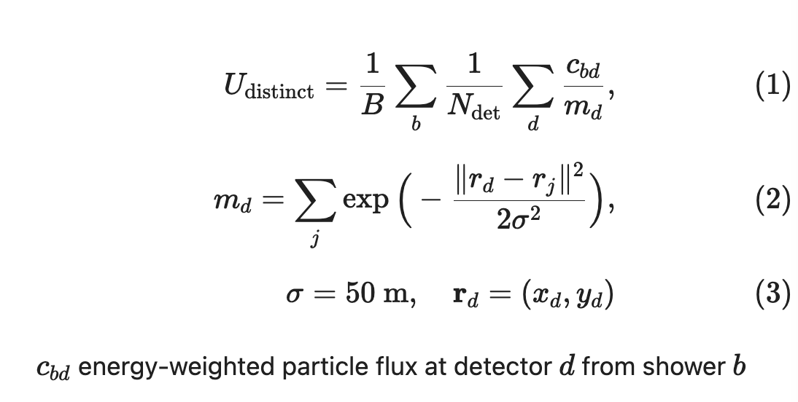
Stage 4: Detector array optimization – Normalized detector activation
Utility
  defined as total detected energy
  normalized by detector overlap
  Detectors represented as Gaussian in space with sigma=50m
  Based only on the detector response model
Setup
  2 chains initialized at different detector locations: center + grid
  100k primary particles
  Move detector locations based on autodiff
  Optimize first using Adam then LBFGS
Imperfections in detector response model produces lower absolute numbers
Utility (distinct) | Detector response model | Flow matching surrogate
Grid initialization
Baseline grid | 122.12 | 2497.12
Optimized | 158.70 | 3240.04
Center initialization
Baseline center | 3.45 | 68.82
Optimized | 159.08 | 3276.75
Detector response model
FM Model
(tau -> shower)
Tau decay
parameters
x, y detectors
E, T at detectors

Slide 20
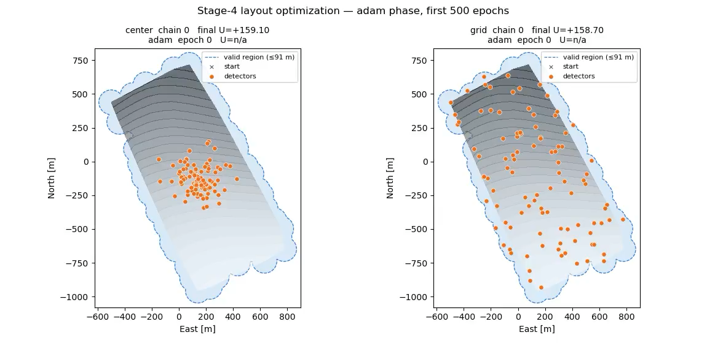
Stage 4: Detector array optimization – Composite utility (2)

Slide 21
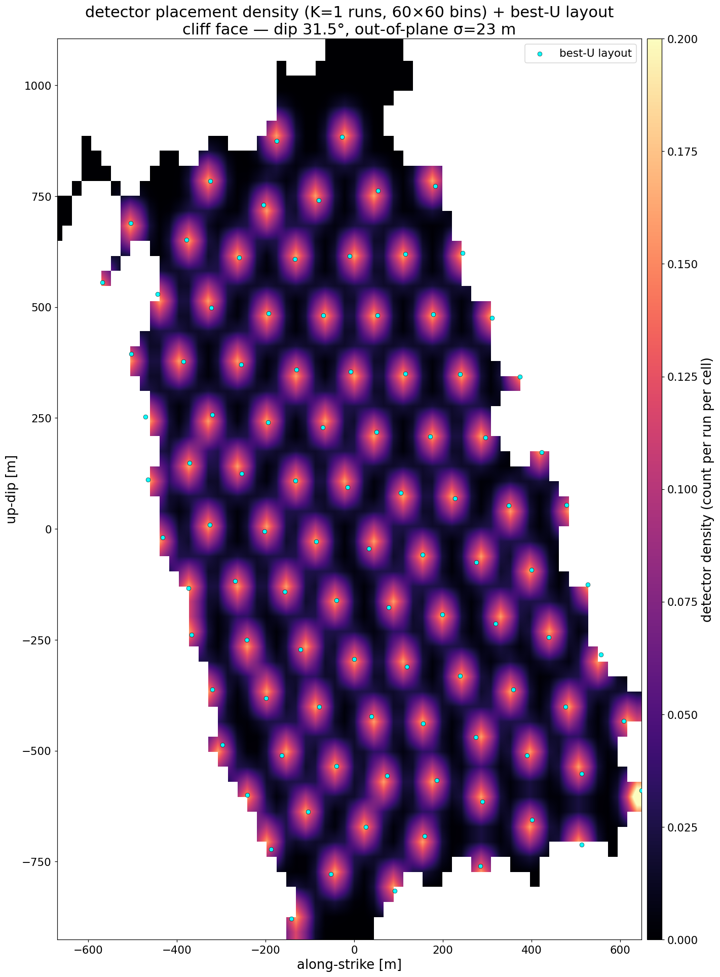
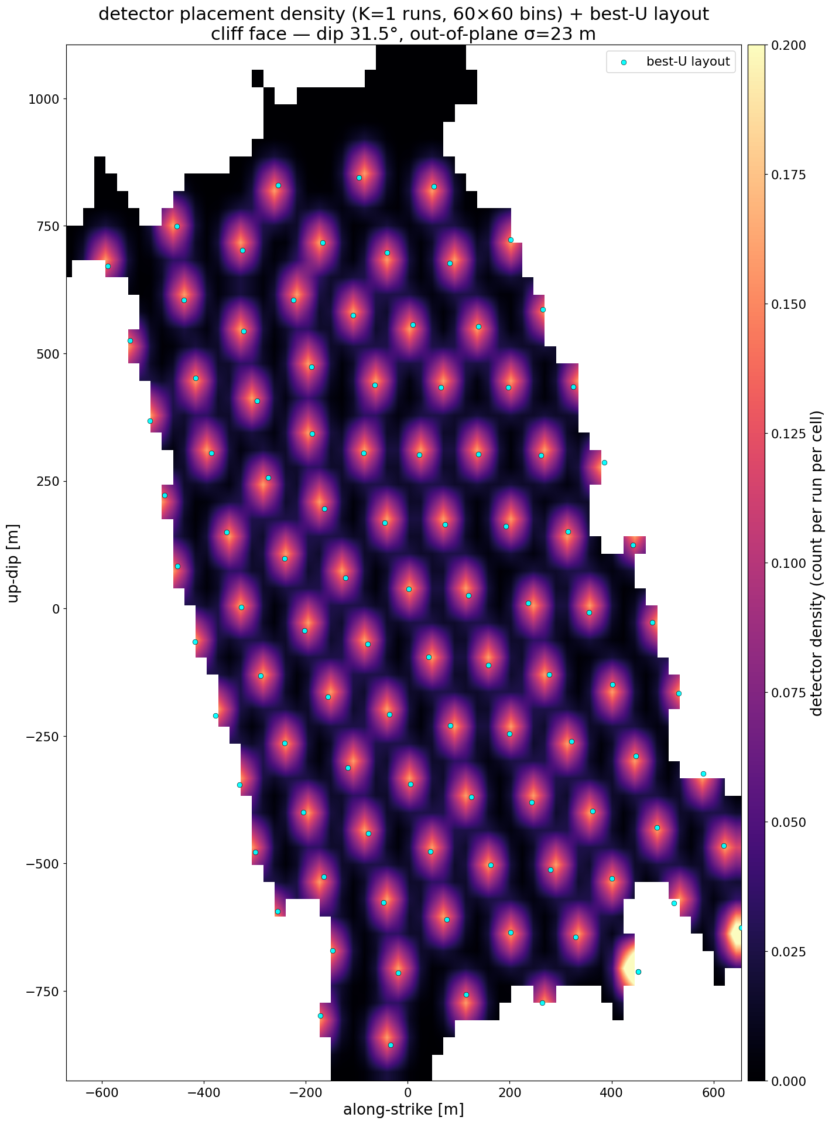
Stage 4: Detector array optimization – Composite utility (3)
Centre initialization
Grid initialization

Slide 22
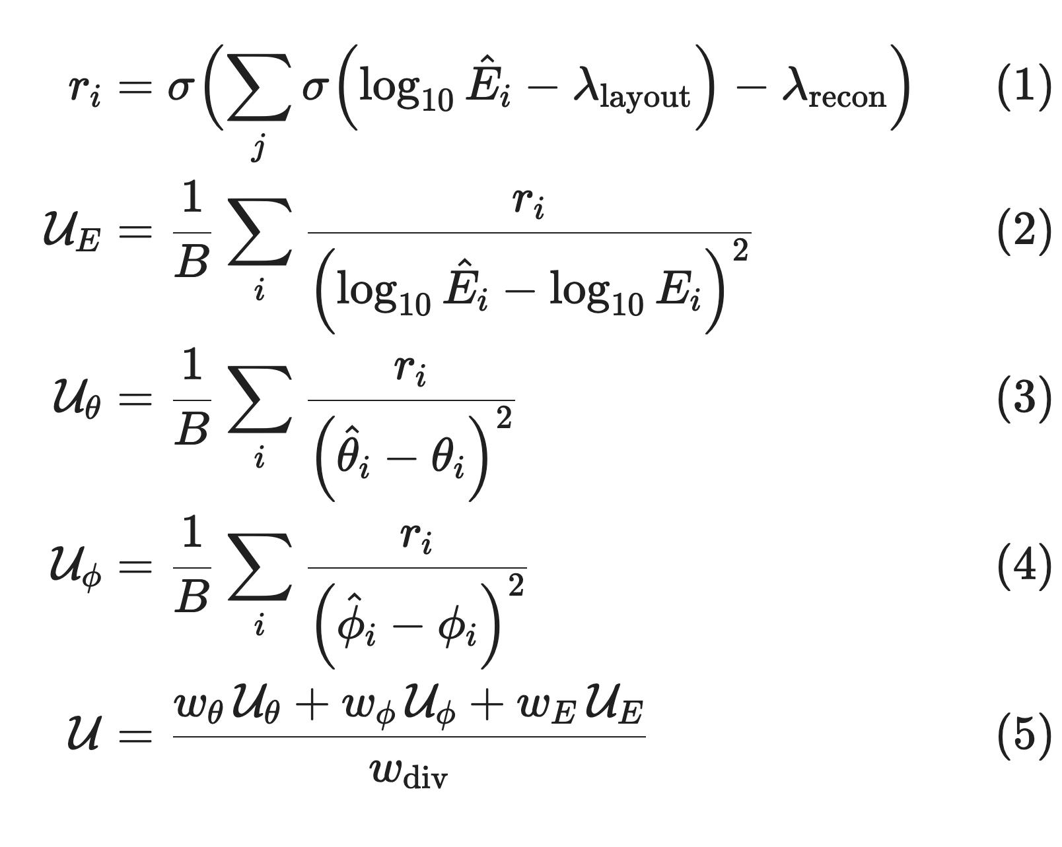
Stage 4: Detector array optimization – Composite utility
Utility function
Use 2x6 chains initialized at different detector locations
100k primary particles
Move detector locations based on autodiff
Optimize first using Adam then LBFGS
Verdict
  Successfully optimizes the detector array on the deepsets model
  There is a discrepancy to the unseen stochastic showers
Utility | Detector response model | Flow matching surrogate
Grid initialization
Baseline grid | 32.10 | 23.48
Optimized | 34.98 | 24.51
Center initialization
Baseline center | 10.77 | 9.58
Optimized | 34.97 | 24.35
Detector response model
Reconstruction model
FM Model
(tau -> shower)
Reconstruction NN
(detected shower -> tau)
Tau decay
parameters
Utility (reconstructed tau)
.backward()
x, y locations (trainable)
x, y locations (trainable)

Slide 23
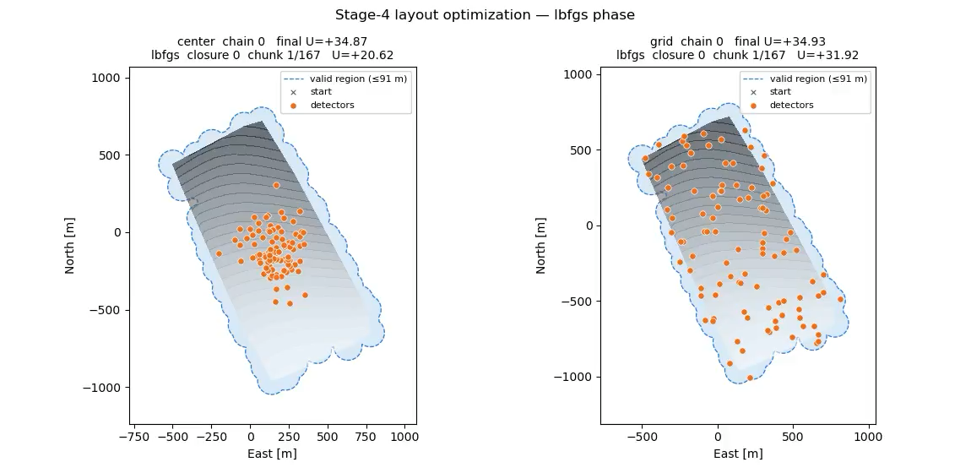
Stage 4: Detector array optimization – Composite utility (2)

Slide 24
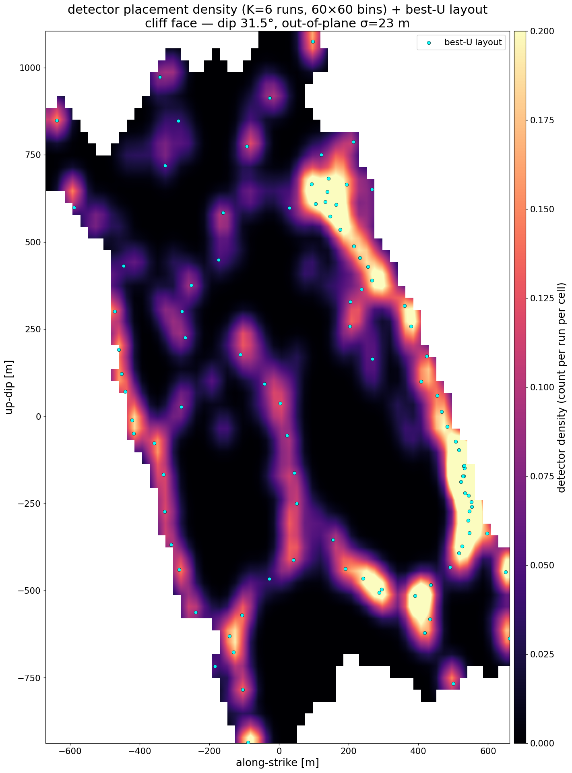
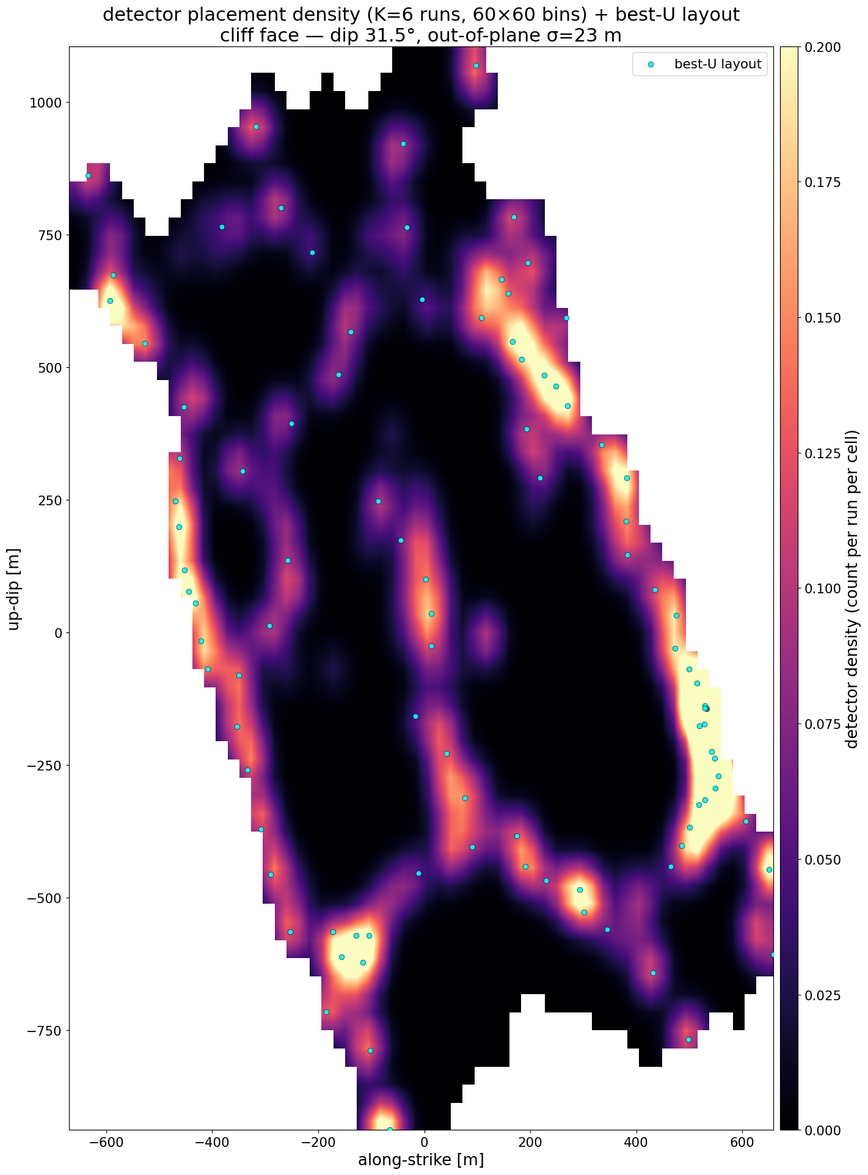
Stage 4: Detector array optimization – Composite utility (3)
Centre initialization
Grid initialization

Slide 25
Conclusion
A high number of paramters need to be optimized in the Tambo observatory.
A gradient-based method was proposed.
A surrogate representing both architecture and primary particle paramter is used to optimize the array.
Several optimization chains.
Next steps
Add additional constraints about detector positions (preferred locations).

Slide 26
Thank you for your attention!
z.dimitrov308@proton.me

Slide 27
Additional slides

Slide 28
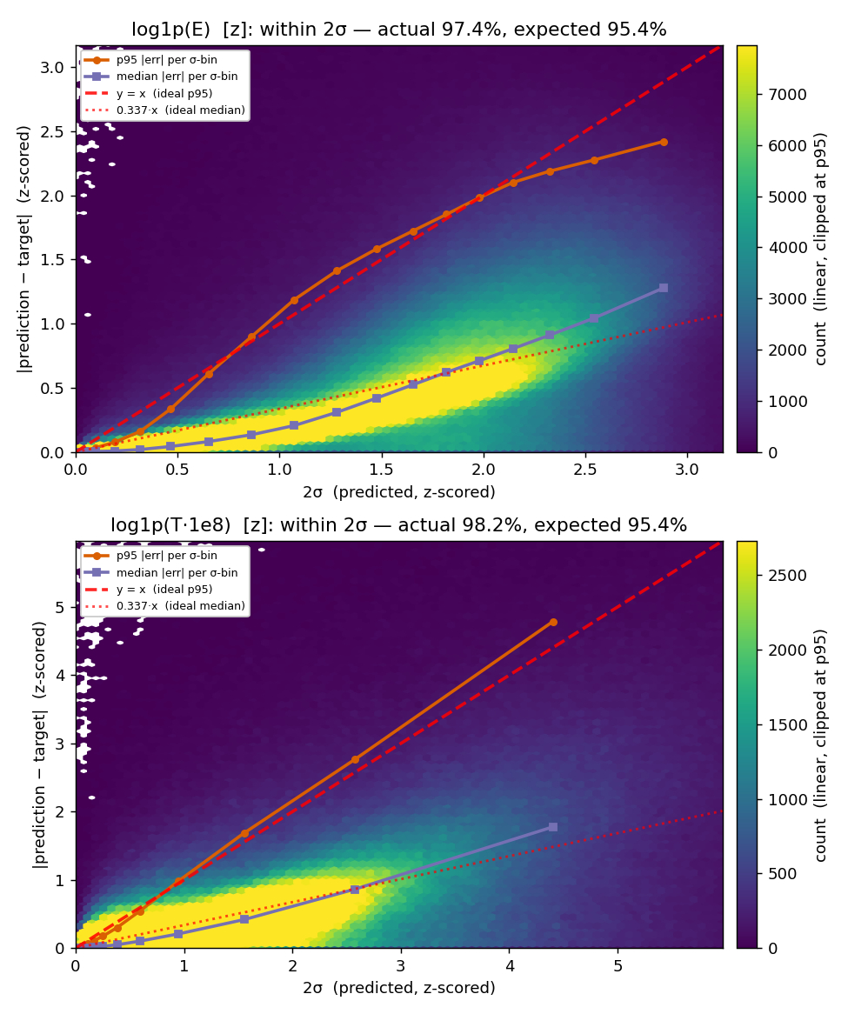
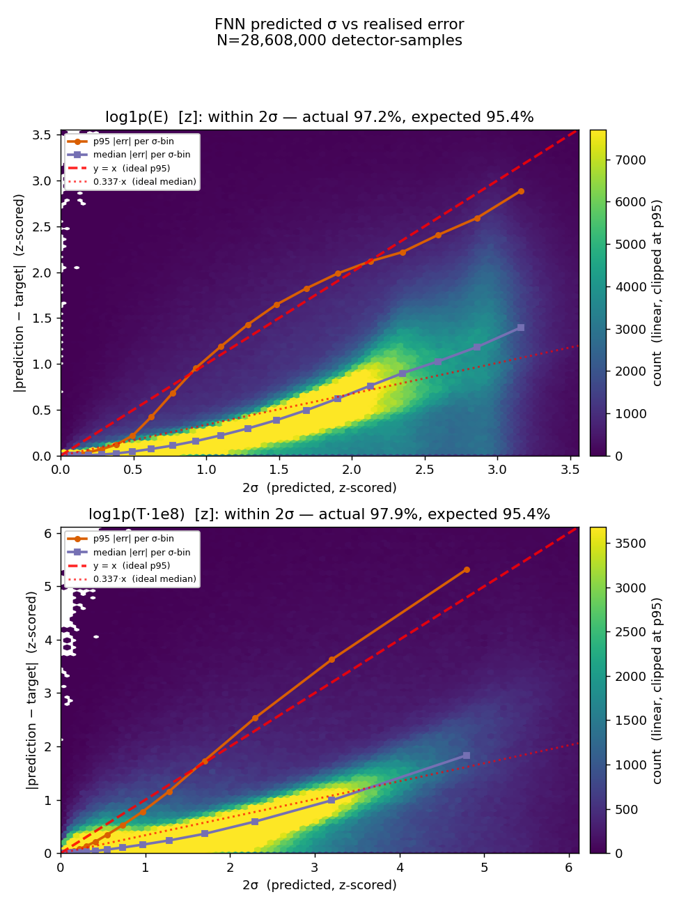


Stage 2: Detector response model – UQ
FNN predicted 2 $σ$ vs realised error (electrons)
FNN predicted 2 $σ$ vs realised error (muons)

Slide 29
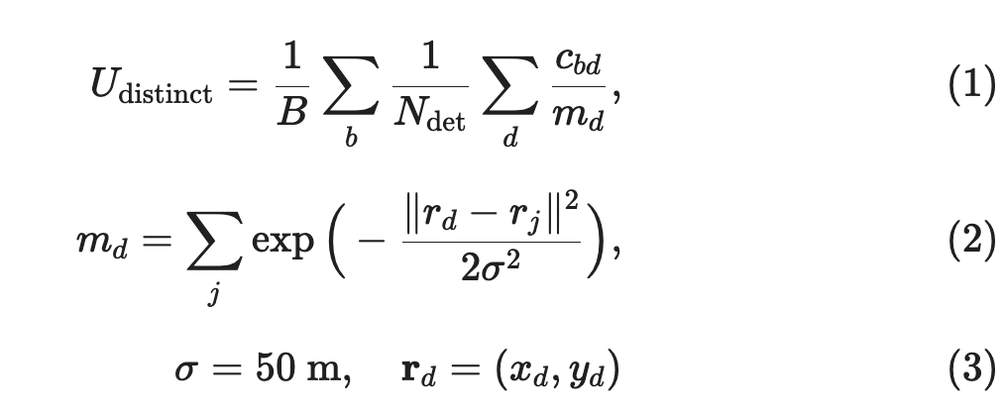
Stage 4: Detector array optimization – Normalized detector activation
Utility
  defined as total detected energy
  normalized by detector overlap
  Detectors represented as Gaussian in space with sigma=50m
  Based only on the detector response model
Evaluate on composite utility comparisson
Utility | Detector response model | Flow matching surrogate
Grid initialization
Baseline grid | 32.10 | 23.48
Optimized | 32.54 | 24.01
Center initialization
Baseline center | 10.77 | 9.58
Optimized | 32.63 | 24.06
Detector response model
FM Model
(tau -> shower)
Tau decay
parameters
E, T at detectors

